Slide 1
Chapter 4
The Tissue Level of Organization

Slide 2
INTRODUCTION
A tissue is a group of similar cells that are specialized for a particular function.
The cells as well as the extracellular fluid in tissues determine its function

Slide 3
BASIC TISSUE TYPES
Four principal types based on function and structure
Epithelial tissue
  covering, lining, and forms glands.
Connective tissue
  protects and supports, binds tissues, stores energy, and provides immunity.
Muscle tissue
  movement and generation of force.
Nervous tissue
  communication and control

Slide 4
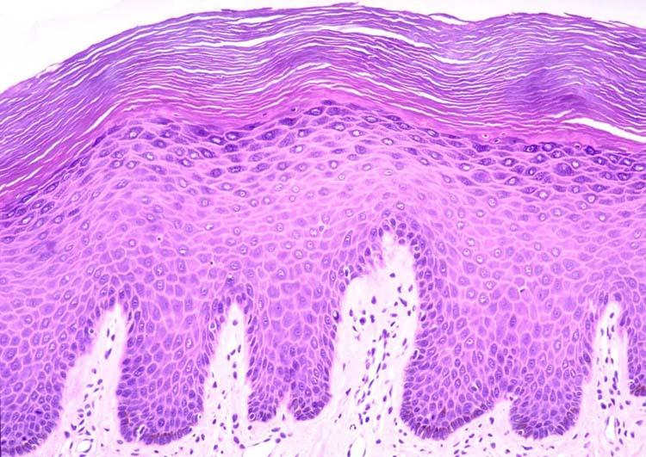
EPITHELIAL TISSUES

Slide 5
Epithelial Tissue -- General Features
Closely packed cells with little extracellular material
Polarity
  Apical (upper) free surface
  Basal surface against basement membrane
Avascular---without blood vessels
  nutrients and waste must move by diffusion
Good nerve supply
Rapid cell division (high mitotic rate)

Slide 6
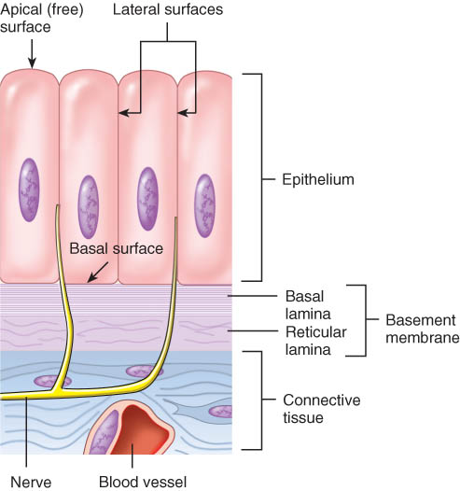
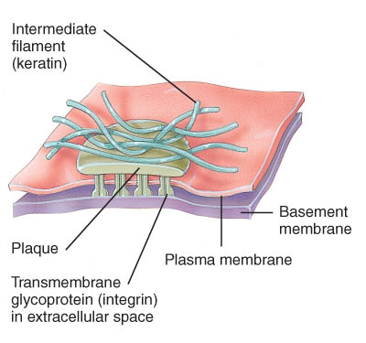
Basement Membrane
Basal lamina
  from epithelial cells
  collagen fibers
Reticular lamina
  secreted by connective tissue cells
  reticular fibers

Slide 7
Epithelial Tissue either
Covering and lining epithelium
  These are the types we saw in lab
  May be “simple” or multi-layered
Glandular epithelium
  Two types:
    Exocrine - connected to the surface by tubes (ducts)
      May be classified either by structure or function
      Eg. sweat, ear wax, saliva, digestive enzymes
    Endocrine - secrete hormones into the bloodstream
      Eg. Thyroid, adrenal, anterior pituitary

Slide 8
Specific Types of Simple Epithelium
Simple Squamous Epithelium –flat cells
    very thin --- controls diffusion, osmosis and filtration
    Examples: alveoli, outer layer of intestine
Simple Cuboidal Epithelium – square-ish
    adapted for absorption or secretion
    Examples: tubules, ducts, glands
Simple Columnar Epithelium – rectangular
    Include unicellular glands (goblet cells) secrete mucus
    Cells often have Microvilli – adapted for absorption
    Examples: lining the inside of the GI, respiratory, reproductive and urinary systems
Ciliated Simple Columnar Epithelium
    Cilia (motile membrane extensions) move mucous
    Examples: found in respiratory system and in uterine tubes
Pseudostratified Ciliated Columnar Epithelium
    Single cell layer of cells with nuclei located at varying depths (appear layered.)
    Examples: trachea, male urethra & epididymis

Slide 9
Specific Types of Multi-layered Epithelium
Non-keratinized stratified squamous epithelium - Cells on surface are flat
    Mitosis occurs at the basal layer
    E.g. Inside of cheek, vagina, esophagus
Keratinized stratified squamous epithelium - Cells on surface are flat
    Mitosis occurs at the basal layer
    Cells (especially at the top layer) are filled with keratin
    E.g. epidermis
Transitional epithelium – variable shape
    surface cells varying in shape - round to flat (if stretched)
    E.g. – urinary bladder, ureter
Stratified cuboidal epithelium
Stratified columnar epithelium

Slide 10
Glandular Epithelium
Exocrine Glands
Secrete ---sweat, ear wax, saliva, digestive enzymes onto free surface of epithelial layer
Endocrine Glands
Secrete hormones into the bloodstream

Slide 11
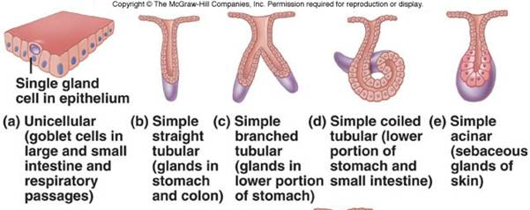
Exocrine Glands
Structural Classification
  Unicellular (single-celled) glands
    goblet cells
  Multicellular glands
    branched (compound) or unbranched (simple)
    tubular or acinar (flask-like) shape

Slide 12
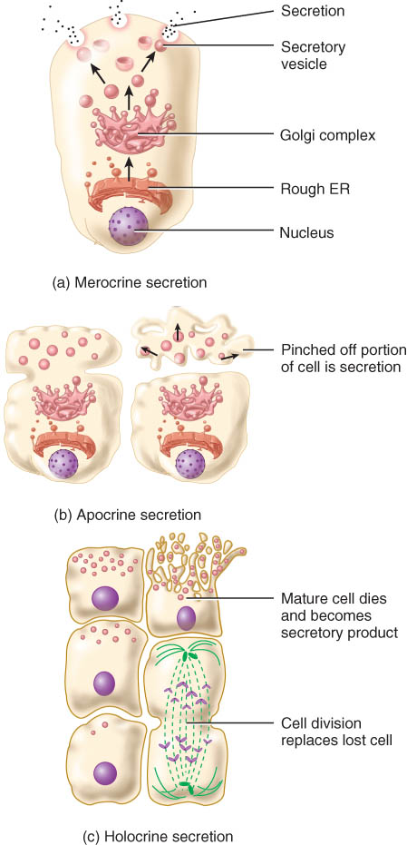
Exocrine Glands – Functional Classification
Merocrine glands: The most common subtype, merocrine gland secretions exit the cell via exocytosis. This method of secretion does not damage the cell. An example of merocrine secretion is the eccrine sweat gland.
Apocrine glands: These form buds of the membrane that break off into the duct, losing part of the cellular membrane in the process. A well-known apocrine gland is the breastmilk-producing mammary gland.
Holocrine glands: The cellular membrane of holocrine glands ruptures to release its product into the duct. Sebaceous (oil) glands represent holocrine secretion.

Slide 13
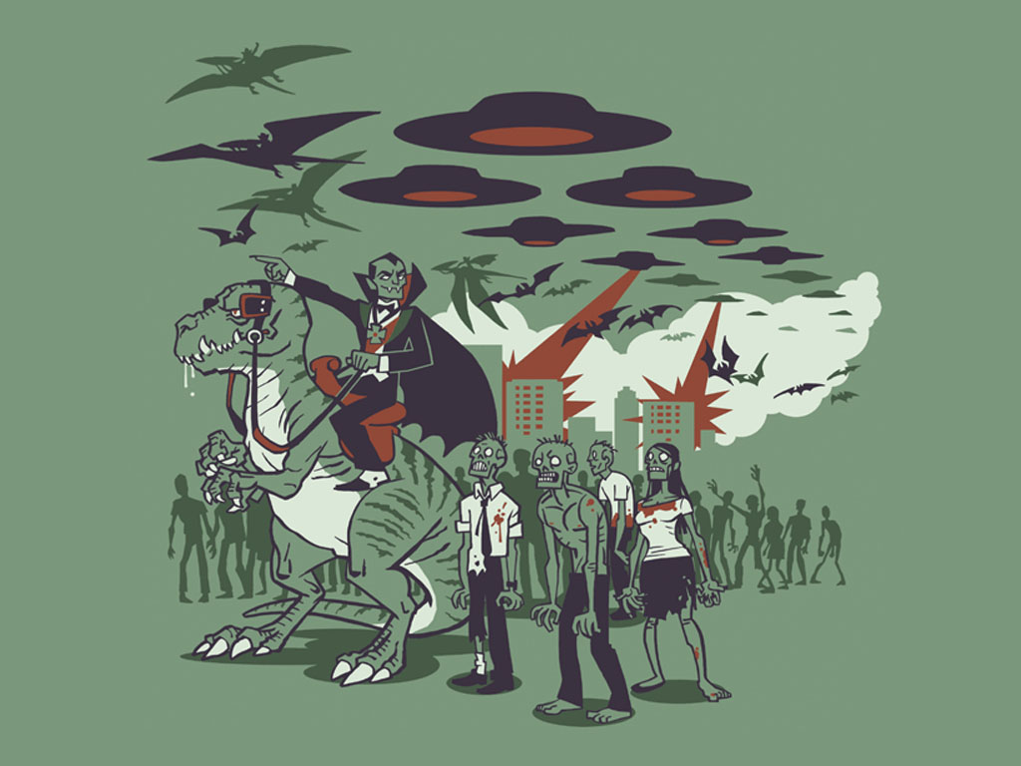
Connective Tissue

Slide 14
Connective Tissues – General Features
Cells rarely touch due to “extracellular matrix.”
Matrix (fibers & ground substance) is secreted by cells
  Collagen fibers
    composed of the protein collagen
    tough and resistant to stretching
  Elastic fibers
    composed of the protein elastin
    provide strength and stretching capacity
  Reticular fibers
    composed of collagen and glycoprotein
    supporting network
Good nerve & blood supply except in cartilage & tendons

Slide 15
Types of Mature Connective Tissue
Proper connective tissue
Cartilage
  Hyaline, elastic, and fibrocartilage
Bone tissue
  Compact and spongy (sometimes called trabecular)
Blood and Lymph

Slide 16
I. Proper Connective Tissue
Loose connective tissue - Loosely woven fibers throughout tissues
  Areolar connective tissue
    Elastic and collagen fibers
    eg. Subcutaneous layer
  Adipose – fat
    Yellow fat - Example: Deeper layer of skin, organ padding, yellow marrow
      Peripheral nuclei due to large fat storage droplet
    Brown fat – found in infants
  Reticular connective tissue
    Network of fibers & cells that produce framework of organ
    Holds organ together
    Examples: liver, spleen, lymph nodes, bone marrow

Slide 17
I. Proper Connective Tissue
Dense connective tissue – Densely woven fibers throughout tissues
  Dense regular connective tissue – eg. Tendons and ligaments
  Dense irregular connective tissue – eg. White of eyeball, dermis of skin
  Elastic connective tissue
    Branching elastic fibers and fibroblasts
    Can stretch & still return to original shape
    Examples: Lung tissue, vocal cords, ligament between vertebrae

Slide 18
II. Cartilage
Cartilage consists of a dense network of collagen fibers and elastic fibers embedded in chondroitin sulfate.
  Chondrocytes occur with spaces called lacunae in the matrix.
It is surrounded by perichondrium.
Unlike other connective tissues, cartilage has no blood vessels or nerves (except in the perichondrium).
3 types:
  Hyaline cartilage - Reduces friction at joints as articular cartilage
  Elastic cartilage
    Elastic fibers help maintain shape
    Ear, epiglottis, eustachian tube
  Fibrocartilage
    Many more collagen fibers causes rigidity & stiffness
    Strongest type of cartilage (intervertebral discs)

Slide 19
Growth & Repair of Cartilage
Grows and repairs slowly because it is avascular
Interstitial growth
  chondrocytes divide and form new matrix
  occurs in childhood and adolescence
Appositional growth – growth in width
  chondroblasts secrete matrix onto surface

Slide 20
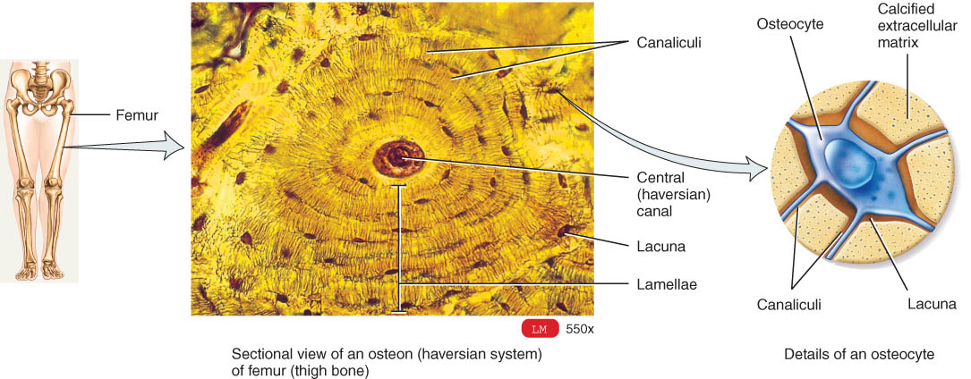
III. Bone (Osseous) Tissue
Protects, provides for movement, stores minerals, site of blood cell formation
consists of a matrix containing mineral salts and collagenous fibers and cells called osteocytes.
  Spongy bone
    sponge-like with spaces and trabeculae
  Compact bone
    solid, dense bone
    basic unit of structure is osteon (Haversian system)

Slide 21
IV. Liquid connective tissue
Blood
  liquid matrix called plasma
  Cell types:
    Red blood cells (erythrocytes) – Oxygen transport
    White blood cells (leukocytes) – Immune response
    Platelets (thrombocytes) – blood clotting
Lymph is interstitial fluid flowing in lymph vessels.
  Contains less protein than plasma
  Move cells and substances (eg., lipids) from one part of the body to another

Slide 22
MEMBRANES
Membranes are flat sheets of pliable tissue that cover or line a part of the body.
Epithelial membranes include
  Mucous membranes - line cavities that open to the exterior (e.g. mouth, stomach, vagina, urethra)
  Serous membranes (serosa) - Lines a body cavity that does not open to the outside such as chest or abdominal cavity
    - Examples: pleura, peritoneum and pericardium
    Serous membrane is a thin, double-layered membrane that has two layers:
    - Parietal layer (membrane) – lines the cavity walls
    - Visceral layer (membrane) – covers the organs
    Cutaneous membrane – skin (epidermis and dermis)

Slide 23
MEMBRANES
Connective tissue membranes include:
  Synovial membranes - line joints and contain only connective tissue (no epithelial tissue).

Slide 24
MUSCLE TISSUE
consists of fibers (cells) that are modified for contraction (provide motion, maintenance of posture, and heat.)
Three types.
  Skeletal muscle
    Cells are long cylinders with many peripheral nuclei
    Visible light and dark banding (looks striated)
    Voluntary (conscious control)
  Cardiac muscle
    Cells are branched with one central nucleus
    Involuntary and striated
    intercalated discs contain desmosomes and gap junctions
  Smooth muscle
    Spindle shaped cells with a single central nuclei
    Walls of hollow organs (blood vessels, GI tract, bladder)
    Involuntary and nonstriated

Slide 25
NERVOUS TISSUE
The nervous system is composed of only two principal kinds of cells:
  neurons - nerve cells
  neuroglia - protective and supporting cells

Slide 26
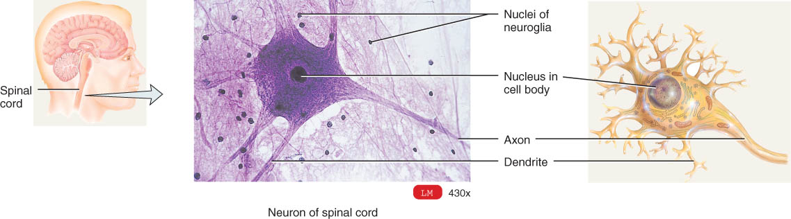
Nerve Tissue
Nerve cell structure
nucleus & long cell processes conduct nerve signals
  dendrite(s) --- signal travels toward the cell body
  axon ---- signal travels away from cell body

